Slide 1
Fair online allocations in {theory, food rescue}
Gerdus Benadè

Slide 2

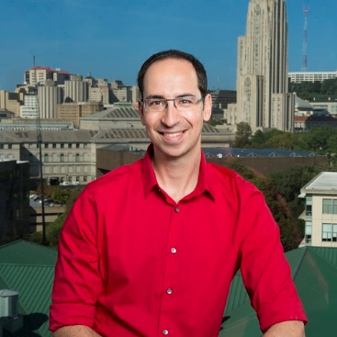


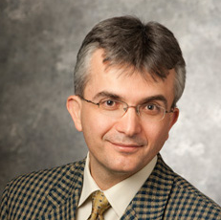

Joint with
Theory
- BKPP EC’18
- BKPPZ OR 2023
- BHP NeurIPS’22
Practice
- AB in progress
Aleks Kazachkov
Ariel Procaccia
David Zeng
Alex Psomas
Aydin Alptekinoglu
Daniel Halpern
Notes:
Setting to keep in mind: food banks

Slide 3


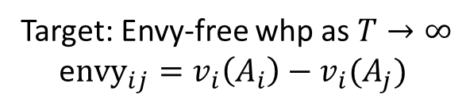
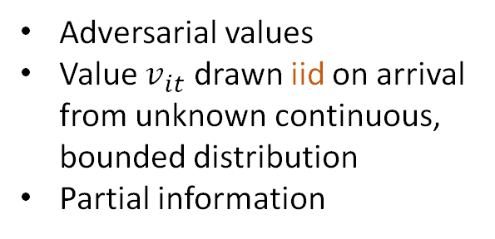
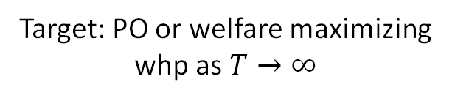
Can we fairly and efficiently allocate goods online?
Target: Envy-free whp as $T→∞$
e$nvy_{ij}=v_{i}\left(A_{i}\right)−v_{i}(A_{j})$
Target: PO or welfare maximizing whp as $T→∞$
Adversarial values
Value $v_{it}$ drawn iid on arrival from unknown continuous, bounded distribution
Partial information
Notes:
EF achievable. EF1 for indivisible. We similarly relax envy – how does it grow?
PO: approximation alpha PO if /1alpha undominatrd
Picture depends on value assumptions

Slide 4


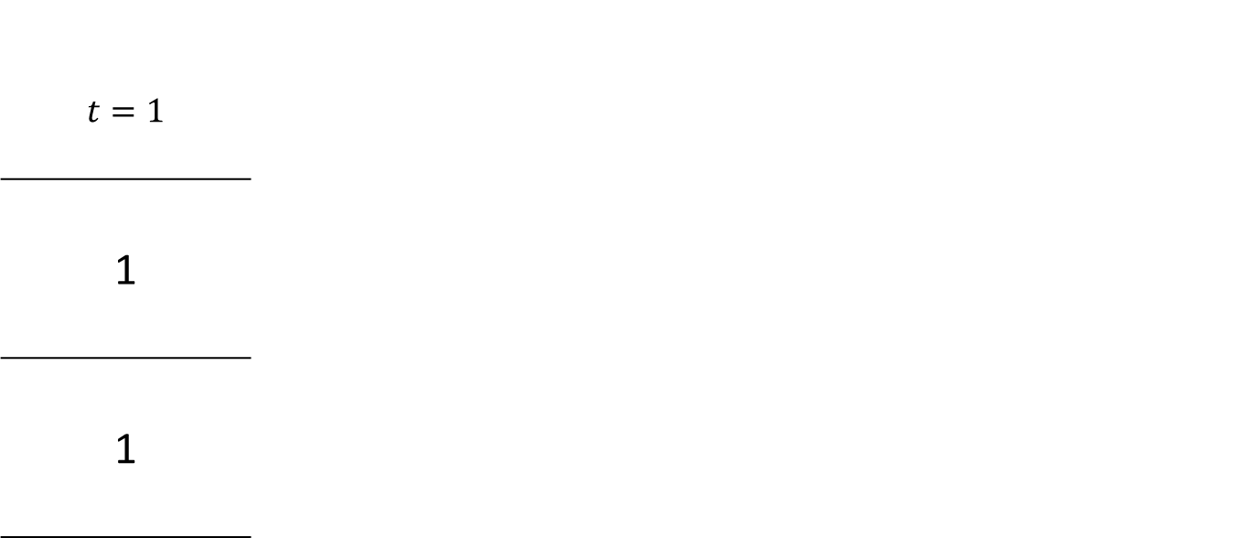
Online fair division
Agents are static, items arrive online [BKPP’18, BKPPZ’22]
$$t=1$$
1
1
Notes:
Adversarial values

Slide 5
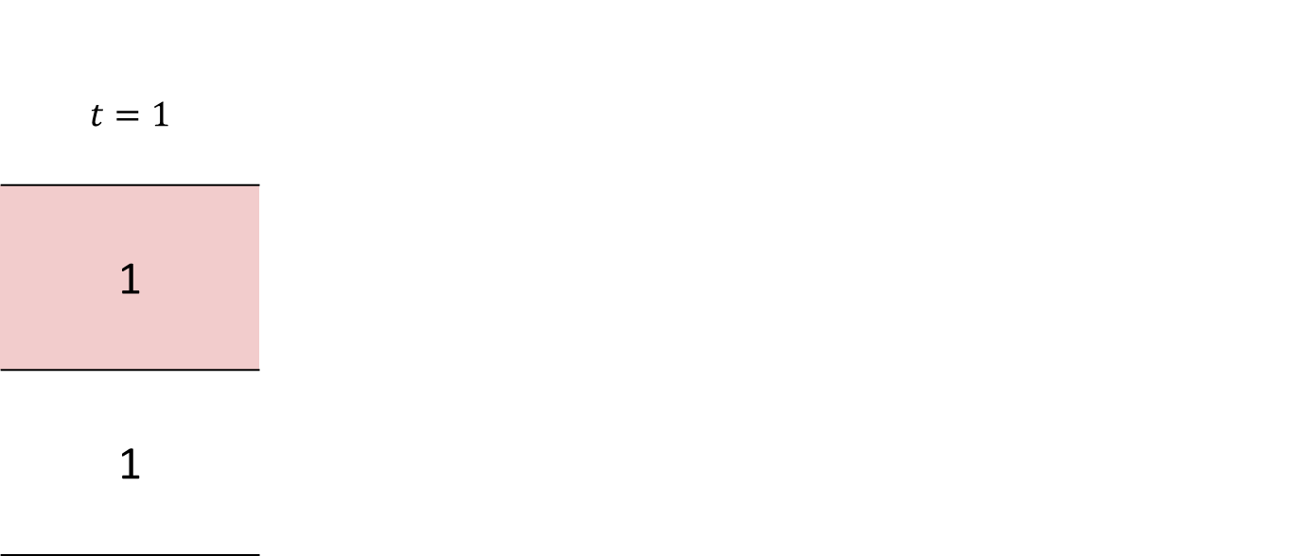
Online fair division
Agents are static, items arrive online [BKPP’18, BKPPZ’22]
$$t=1$$
1
1
Notes:
Adversarial values

Slide 6

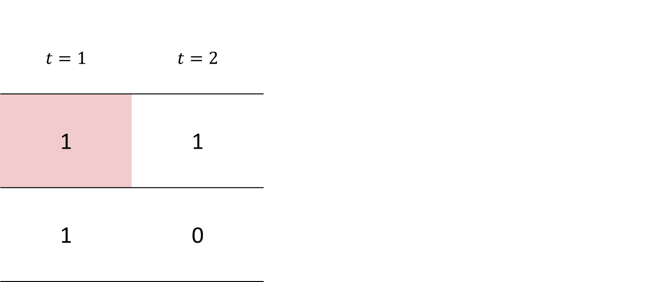
Online fair division
Agents are static, items arrive online [BKPP’18, BKPPZ’22]
$$t=1$$ | $$t=2$$
1 | 1
1 | 0
Notes:
Adversarial values

Slide 7
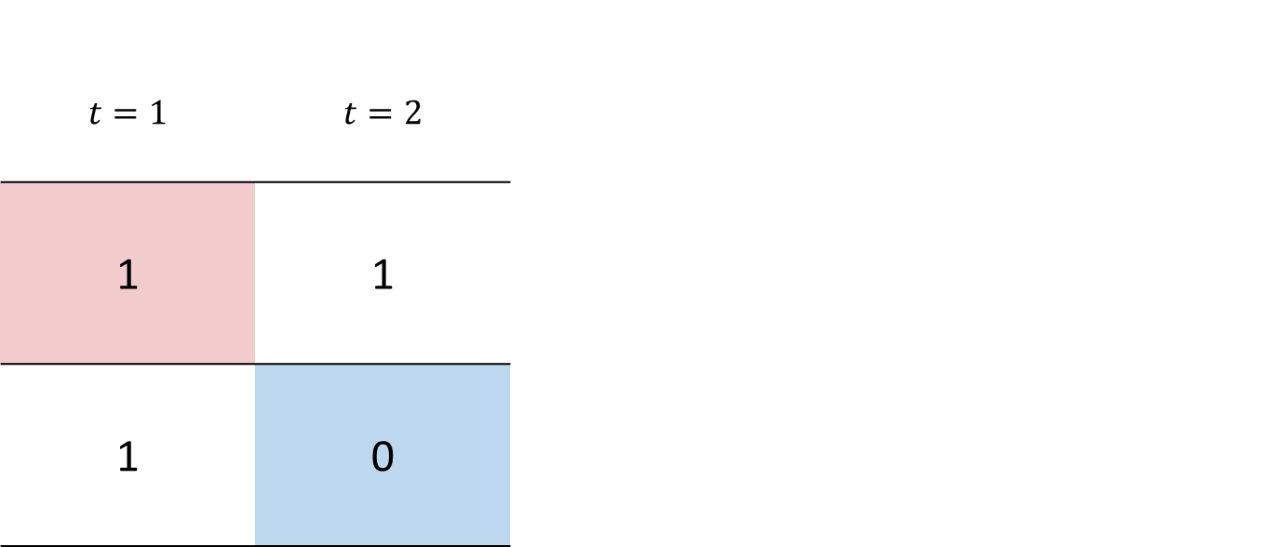
Online fair division
Agents are static, items arrive online [BKPP’18, BKPPZ’22]
$$t=1$$ | $$t=2$$
1 | 1
1 | 0
Notes:
Adversarial values

Slide 8


Online fair division
Agents are static, items arrive online [BKPP’18, BKPPZ’22]
$$t=1$$ | $$t=2$$ | $$t=3$$
1 | 1 | 1/2
1 | 0 | 1/2
Notes:
Adversarial values

Slide 9
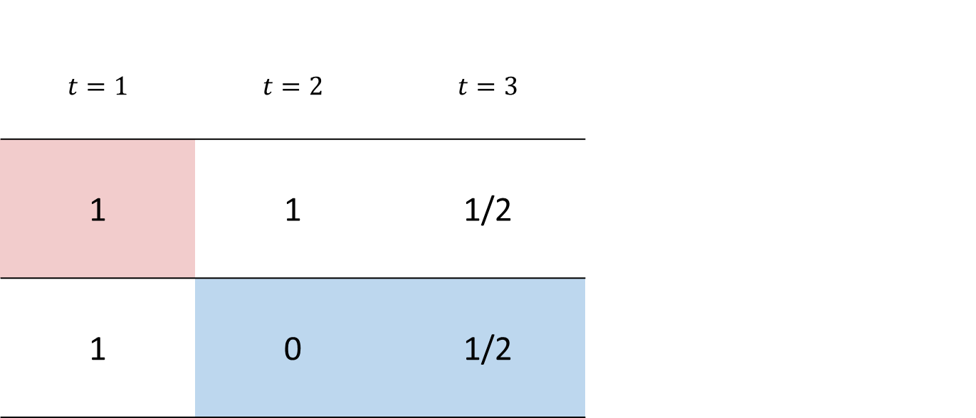
Online fair division
Agents are static, items arrive online [BKPP’18, BKPPZ’22]
$$t=1$$ | $$t=2$$ | $$t=3$$
1 | 1 | 1/2
1 | 0 | 1/2
Notes:
Adversarial values

Slide 10
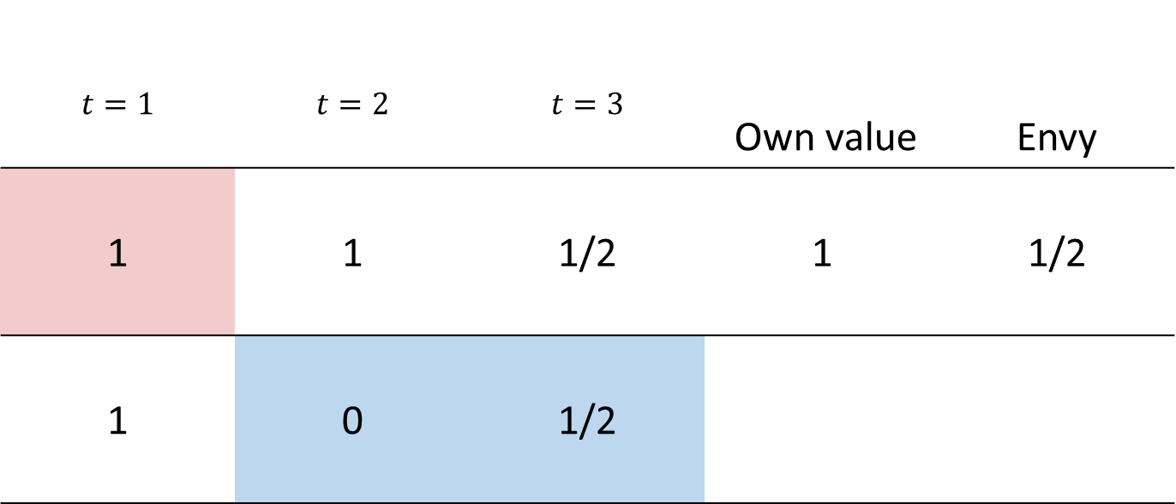
Online fair division
Agents are static, items arrive online [BKPP’18, BKPPZ’22]
$$t=1$$ | $$t=2$$ | $$t=3$$ | Own value | Envy
1 | 1 | 1/2 | 1 | 1/2
1 | 0 | 1/2
Notes:
Adversarial values

Slide 11

Online fair division
Agents are static, items arrive online [BKPP’18, BKPPZ’22]
$$t=1$$ | $$t=2$$ | $$t=3$$ | Own value | Envy
1 | 1 | 1/2 | 1 | 1/2
1 | 0 | 1/2 | 1/2 | 1/2
L
L
Notes:
Adversarial values

Slide 12
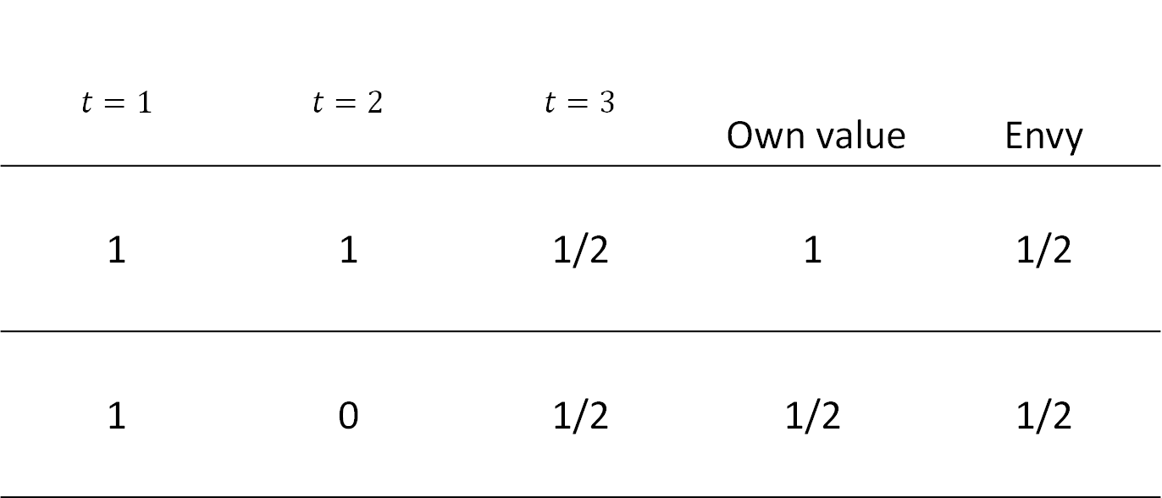
Online fair division
Agents are static, items arrive online [BKPP’18, BKPPZ’22]
$$t=1$$ | $$t=2$$ | $$t=3$$ | Own value | Envy
1 | 1 | 1/2 | 1 | 1/2
1 | 0 | 1/2 | 1/2 | 1/2
L
L
Notes:
Adversarial values

Slide 13
Online fair division
Agents are static, items arrive online [BKPP’18, BKPPZ’22]
$$t=1$$ | $$t=2$$ | $$t=3$$ | Own value | Envy
1 | 1 | 1/2 | 1 | 1/2
1 | 0 | 1/2 | 1/2 | 1/2
L
L
Notes:
Adversarial values

Slide 14
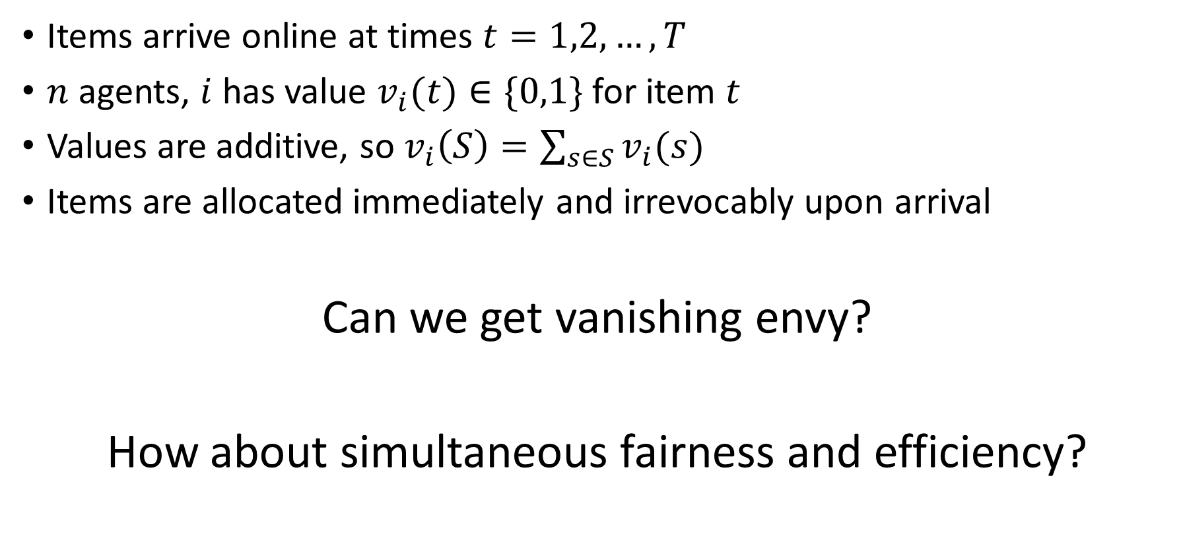
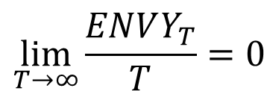
Online fair division
Items arrive online at times $t=1,2,…, T$
$n$ agents, $i$ has value $v_{i}(t)∈\{0,1\}$ for item $t$
Values are additive, so $v_{i}\left(S\right)=\sum_{s∈S}{v_{i}(s)}$
Items are allocated immediately and irrevocably upon arrival
Can we get vanishing envy?
How about simultaneous fairness and efficiency?
$$\lim_{T→∞}{\frac{ENVY_{T}}{T}=0 }$$
Notes:
Some preliminary results about what happens with storage, reassignments etc

Slide 15
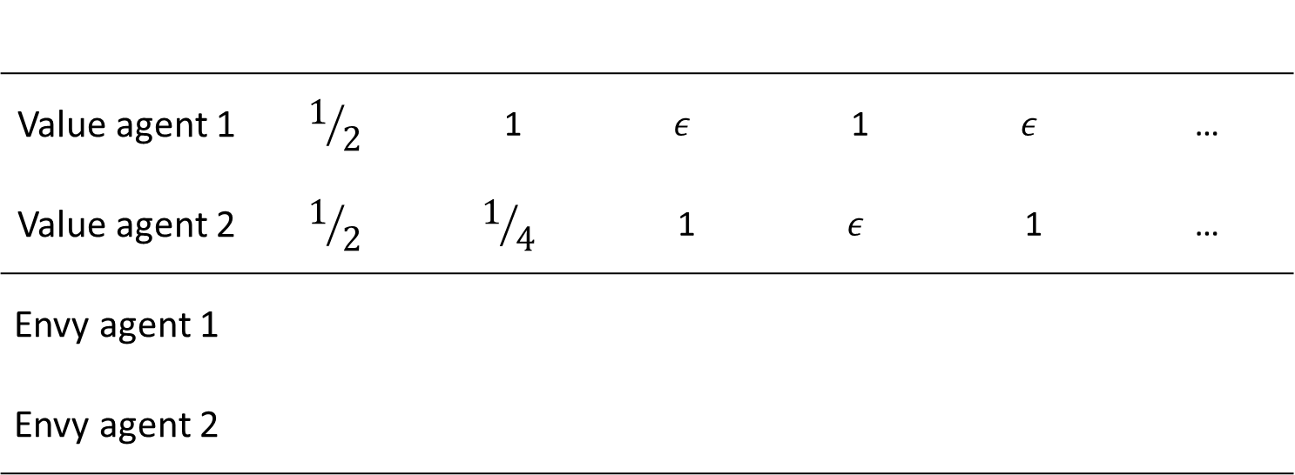
Obvious deterministic strategies fail
Give to whoever has the highest envy
Value agent 1 | $$1/2$$ | 1 | $$ε$$ | 1 | $$ε$$ | …
Value agent 2 | $$1/2$$ | $$1/4$$ | 1 | $$ε$$ | 1 | …
Envy agent 1
Envy agent 2
Notes:
Also to highest value

Slide 16
Obvious deterministic strategies fail
Give to whoever has the highest envy
Value agent 1 | $$1/2$$ | 1 | $$ε$$ | 1 | $$ε$$ | …
Value agent 2 | $$1/2$$ | $$1/4$$ | 1 | $$ε$$ | 1 | …
Envy agent 1
Envy agent 2

Slide 17
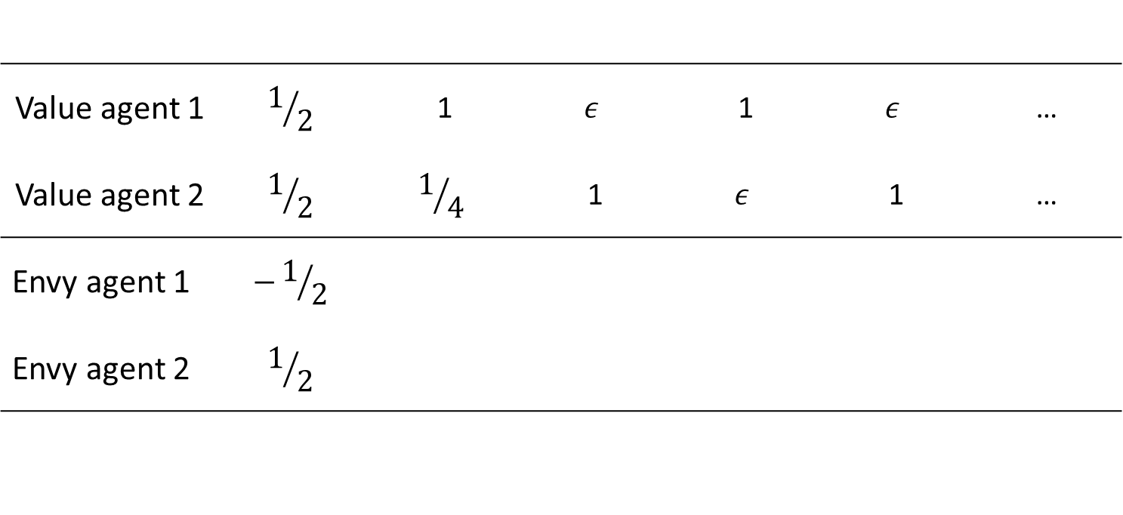
Obvious deterministic strategies fail
Give to whoever has the highest envy
Value agent 1 | $$1/2$$ | 1 | $$ε$$ | 1 | $$ε$$ | …
Value agent 2 | $$1/2$$ | $$1/4$$ | 1 | $$ε$$ | 1 | …
Envy agent 1 | $$−1/2$$
Envy agent 2 | $$1/2$$

Slide 18
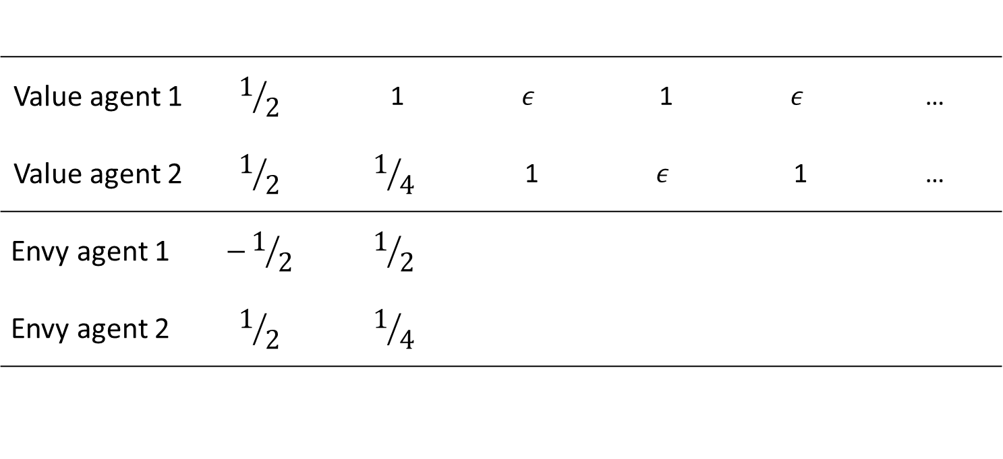
Obvious deterministic strategies fail
Give to whoever has the highest envy
Value agent 1 | $$1/2$$ | 1 | $$ε$$ | 1 | $$ε$$ | …
Value agent 2 | $$1/2$$ | $$1/4$$ | 1 | $$ε$$ | 1 | …
Envy agent 1 | $$−1/2$$ | $$1/2$$
Envy agent 2 | $$1/2$$ | $$1/4$$

Slide 19
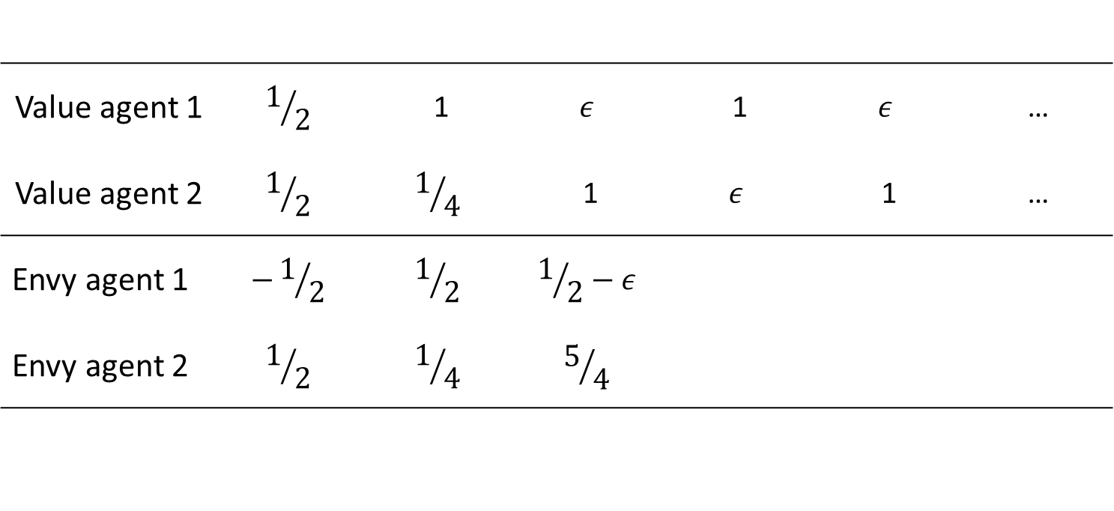
Obvious deterministic strategies fail
Give to whoever has the highest envy
Value agent 1 | $$1/2$$ | 1 | $$ε$$ | 1 | $$ε$$ | …
Value agent 2 | $$1/2$$ | $$1/4$$ | 1 | $$ε$$ | 1 | …
Envy agent 1 | $$−1/2$$ | $$1/2$$ | $$1/2−ε$$
Envy agent 2 | $$1/2$$ | $$1/4$$ | $$5/4$$

Slide 20
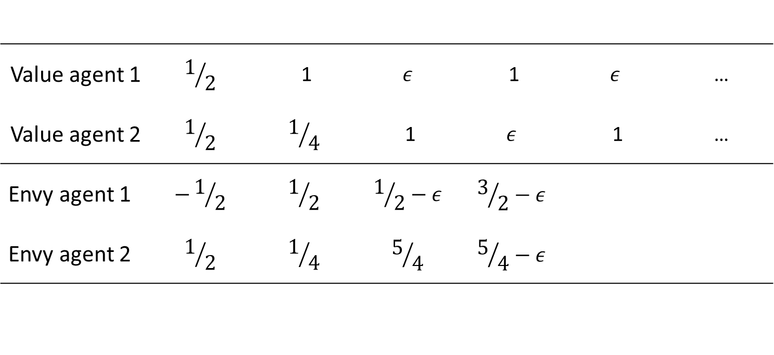
Obvious deterministic strategies fail
Give to whoever has the highest envy
Value agent 1 | $$1/2$$ | 1 | $$ε$$ | 1 | $$ε$$ | …
Value agent 2 | $$1/2$$ | $$1/4$$ | 1 | $$ε$$ | 1 | …
Envy agent 1 | $$−1/2$$ | $$1/2$$ | $$1/2−ε$$ | $$3/2−ε$$
Envy agent 2 | $$1/2$$ | $$1/4$$ | $$5/4$$ | $$5/4−ε$$

Slide 21
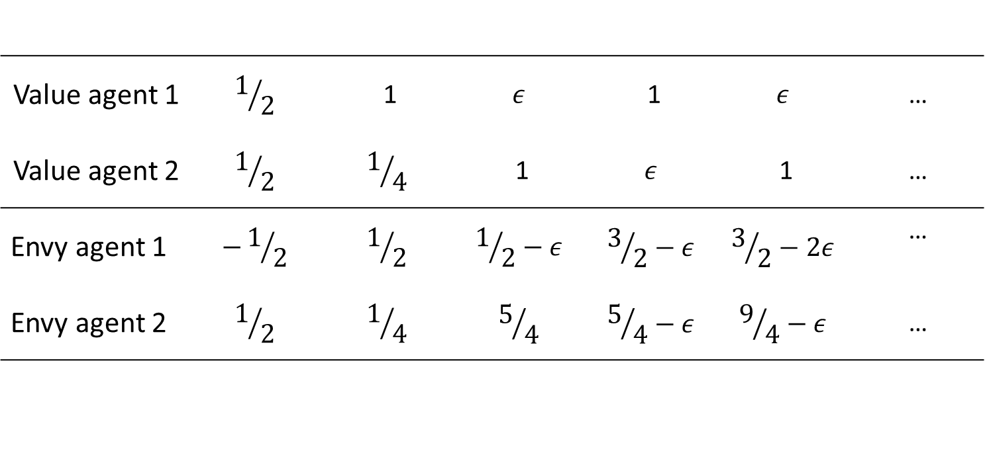
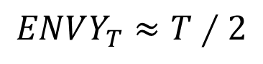
Obvious deterministic strategies fail
Give to whoever has the highest envy
Value agent 1 | $$1/2$$ | 1 | $$ε$$ | 1 | $$ε$$ | …
Value agent 2 | $$1/2$$ | $$1/4$$ | 1 | $$ε$$ | 1 | …
Envy agent 1 | $$−1/2$$ | $$1/2$$ | $$1/2−ε$$ | $$3/2−ε$$ | $$3/2−2ε$$ | …
Envy agent 2 | $$1/2$$ | $$1/4$$ | $$5/4$$ | $$5/4−ε$$ | $$9/4−ε$$ | …
$$ENVY_{T}≈T∕2$$
Notes:
Linear envy also for giving to highest value agent

Slide 22
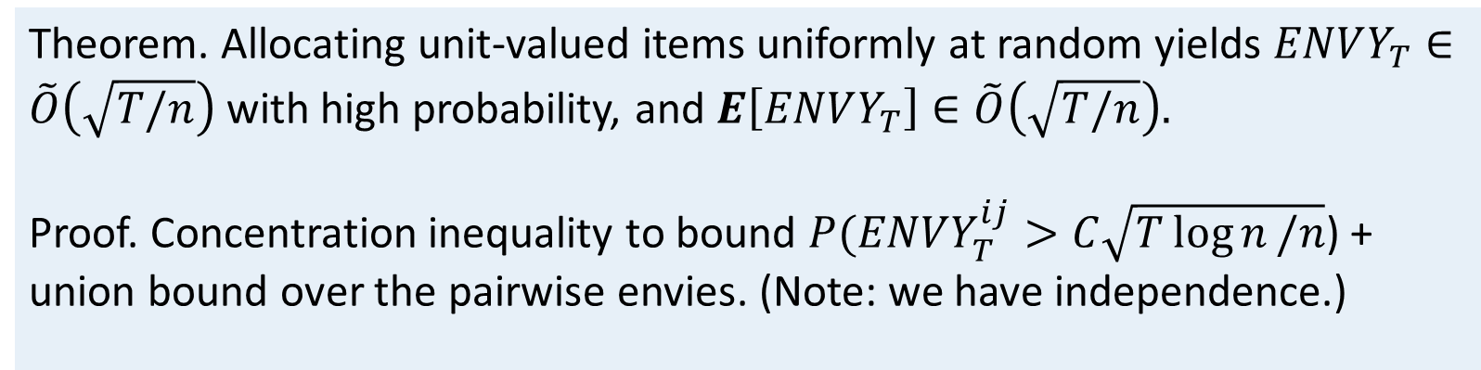
Random allocation works
Item values chosen by adaptive adversary
Allocate every item uniformly at random.
Pretend that every agent values every item at 1.
Theorem. Allocating unit-valued items uniformly at random yields $ENVY_{T}∈\tilde{O}\left(\sqrt{T/n}\right)$ with high probability, and $E\left[ENVY_{T}\right]∈\tilde{O}\left(\sqrt{T/n}\right).$
Proof. Concentration inequality to bound $P(ENVY_{T}^{ij}>C\sqrt{T\log{n}/n}$) + union bound over the pairwise envies. (Note: we have independence.)

Slide 23
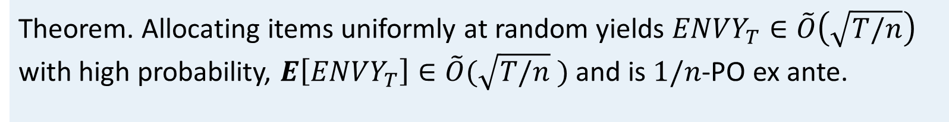
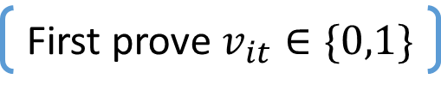
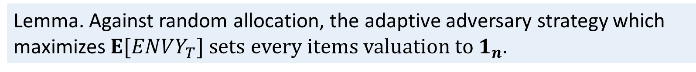
Random allocation works
Item values chosen by adaptive adversary
Allocate every item uniformly at random.
Pretend that every agent values every item at 1.
First prove $v_{it}∈\{0,1\}$
Lemma. Against random allocation, the adaptive adversary strategy which maximizes $E[ENVY_{T}]$ sets every items valuation to $1_{n}.$
Theorem. Allocating items uniformly at random yields $ENVY_{T}∈\tilde{O}\left(\sqrt{T/n}\right)$ with high probability, $E\left[ENVY_{T}\right]∈\tilde{O}(\sqrt{T/n}$ ) and is $1/n$-PO ex ante.
Notes:
1/n PO – actuall welfare optimal – highest value agent gets item wp 1/n

Slide 24

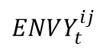
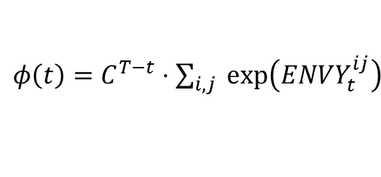
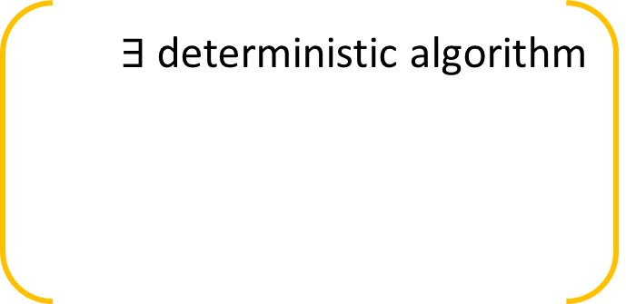
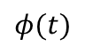
Random allocation works
$∃$ deterministic algorithm
$φ\left(t\right)=C^{T−t}⋅\sum_{i,j}{ exp\left(ENVY_{t}^{ij}\right)}$
$$φ(t)$$
Item values chosen by adaptive adversary
Allocate every item uniformly at random.
Pretend that every agent values every item at 1.
$$ENVY_{t}^{ij}$$
Lemma. Against random allocation, the adaptive adversary strategy which maximizes $E[ENVY_{T}]$ sets every items valuation to $1_{n}.$
Theorem. Allocating items uniformly at random yields $ENVY_{T}∈\tilde{O}\left(\sqrt{T/n}\right)$ with high probability, $E\left[ENVY_{T}\right]∈\tilde{O}(\sqrt{T/n}$ ) and is $1/n$-PO ex ante.
Notes:
Randomization doesn’t help against an adaptive adversary
Derandomize in classic way
Exponential penalty in each of the pairwise functions, minimize potential function greedily

Slide 25
Random allocation works
Item values chosen by adaptive adversary
Allocate every item uniformly at random.
Pretend that every agent values every item at 1.
Lemma. Against random allocation, the adaptive adversary strategy which maximizes $E[ENVY_{T}]$ sets every items valuation to $1_{n}.$
Theorem. Allocating items uniformly at random yields $ENVY_{T}∈\tilde{O}\left(\sqrt{T/n}\right)$ with high probability, $E\left[ENVY_{T}\right]∈\tilde{O}(\sqrt{T/n}$ ) and is $1/n$-PO ex ante.
Theorem. All algorithms have envy $∈Ω(\sqrt{T/n}$ ).

Slide 26
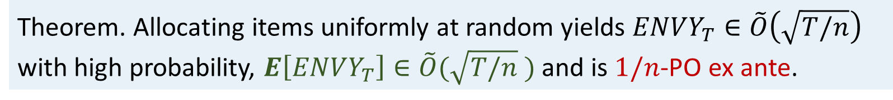
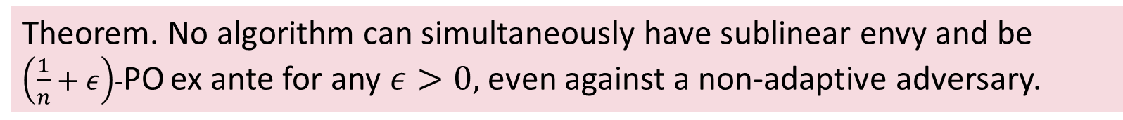
Random allocation (really) works
.
Uniform random allocation is as good as it gets, in a sense
Only care about efficiency: give to agent with highest value
Extensions: delay allocations, reallocate [HPPZ’19], etc.
Theorem. Allocating items uniformly at random yields $ENVY_{T}∈\tilde{O}\left(\sqrt{T/n}\right)$ with high probability, $E\left[ENVY_{T}\right]∈\tilde{O}(\sqrt{T/n}$ ) and is $1/n$-PO ex ante.
Theorem. All algorithms have $E\left[ENVY_{T}\right]∈Ω(\sqrt{T/n}$ ).
Theorem. No algorithm can simultaneously have sublinear envy and be $\left(\frac{1}{n}+ε\right)$-PO ex ante for any $ε>0,$even against a non-adaptive adversary.
Notes:
Impossibility: for both randomized and deterministic against adaptive adversary

Slide 27
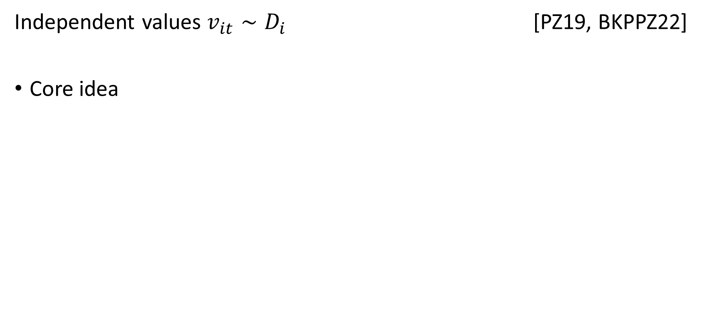
Bayesian setting
Independent values $v_{it}∼D_{i}$ [PZ19, BKPPZ22]
Core idea
[DKG+14] Allocating to agent with highest value is EF and WO whp ($T≥nlog n$)
Theorem. There is no fairness-efficiency tradeoff for iid values
Notes:
Arguments via concetration

Slide 28
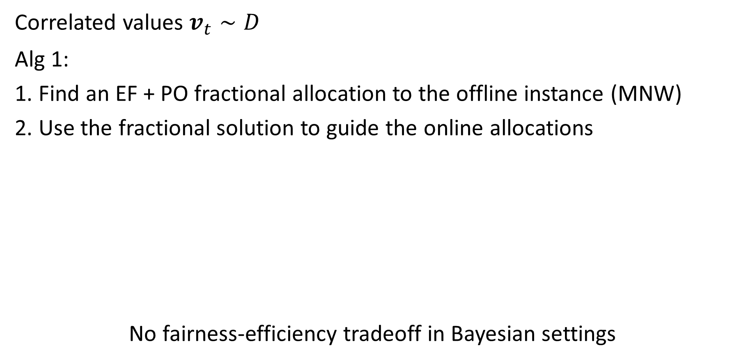
Bayesian setting
Correlated values $v_{t}∼D$
Alg 1:
1. Find an EF + PO fractional allocation to the offline instance (MNW)
2. Use the fractional solution to guide the online allocations
No fairness-efficiency tradeoff in Bayesian settings
Lemma. Rounding a PO fractional allocation gives an ex post PO allocation
Lemma. Alg 1 is ex post PO. For $ε>0, ENVY_{T}^{ij}∈\tilde{O}\left(\sqrt{T/n}\right)$ w.p. at least $1−ε$
Theorem. Alg 1’ is ex post PO and, for $ε>0$, EF w.p. at least $1 −ε$
Notes:
Envy guarantee comes from EF in expectatiaon. Balls in bins argument shows within sqrt of expectation via concentration inequalities
If strictly EF, then the same arguments give EF whp
Random walk interpretation a bit better – EF means mean 0 RW, strictly EF means expectation (-),
General version: I’m lying a little: for each I, j (same values up to scaling) -> EF1; or different values and EF whp

Slide 29
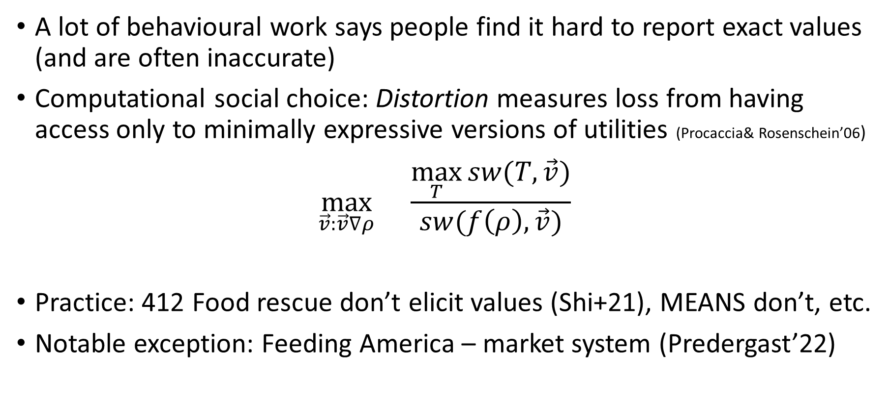
Rethinking the model
A lot of behavioural work says people find it hard to report exact values (and are often inaccurate)
Computational social choice: Distortion measures loss from having access only to minimally expressive versions of utilities (Procaccia& Rosenschein’06)
$$\max_{\vec{v}:\vec{v}∇ρ}{}\frac{\max_{T}{sw(T, \vec{v})}}{sw(f\left(ρ\right), \vec{v})}$$
Practice: 412 Food rescue don’t elicit values (Shi+21), MEANS don’t, etc.
Notable exception: Feeding America – market system (Predergast’22)
Notes:
Market: artificial currency, bid everymorning, carryover etc. high volume, daily bids, some lead time.

Slide 30
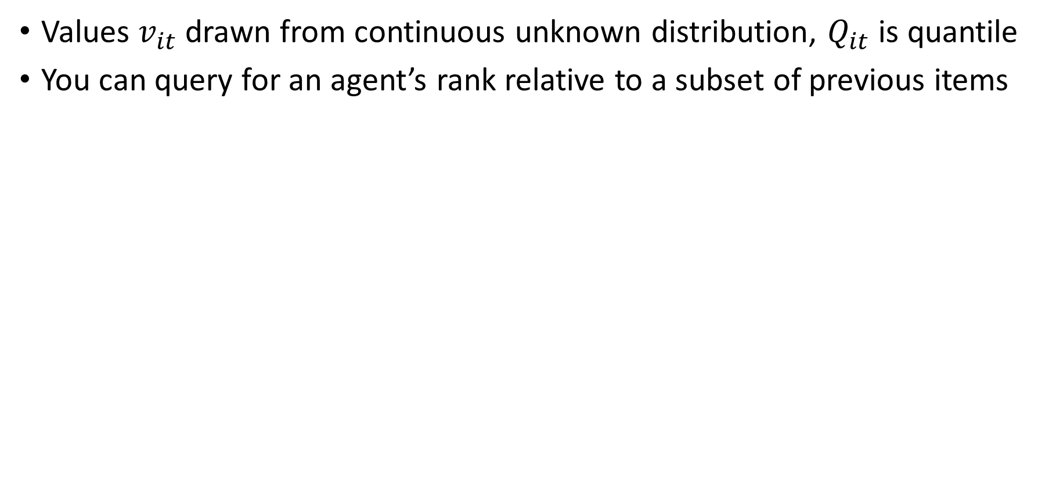
Partial information
Values $v_{it}$ drawn from continuous unknown distribution, $Q_{it}$ is quantile
You can query for an agent’s rank relative to a subset of previous items
Notes:
Adversarial values

Slide 31
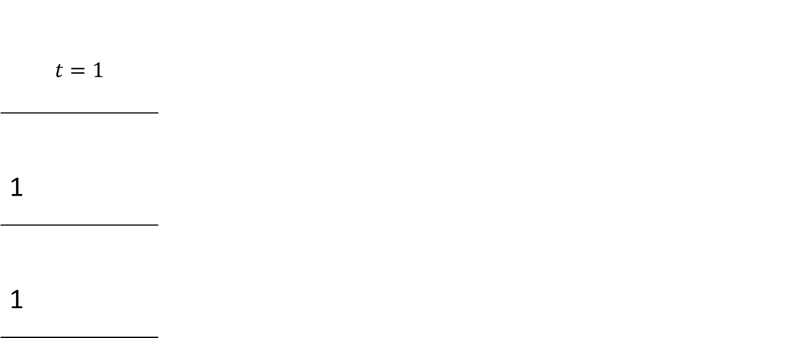
Partial information
Values $v_{it}$ drawn from continuous unknown distribution, $Q_{it}$ is quantile
You can query for an agent’s rank relative to a subset of previous items
$$t=1$$
1
1
1st
1st
Notes:
Adversarial values

Slide 32
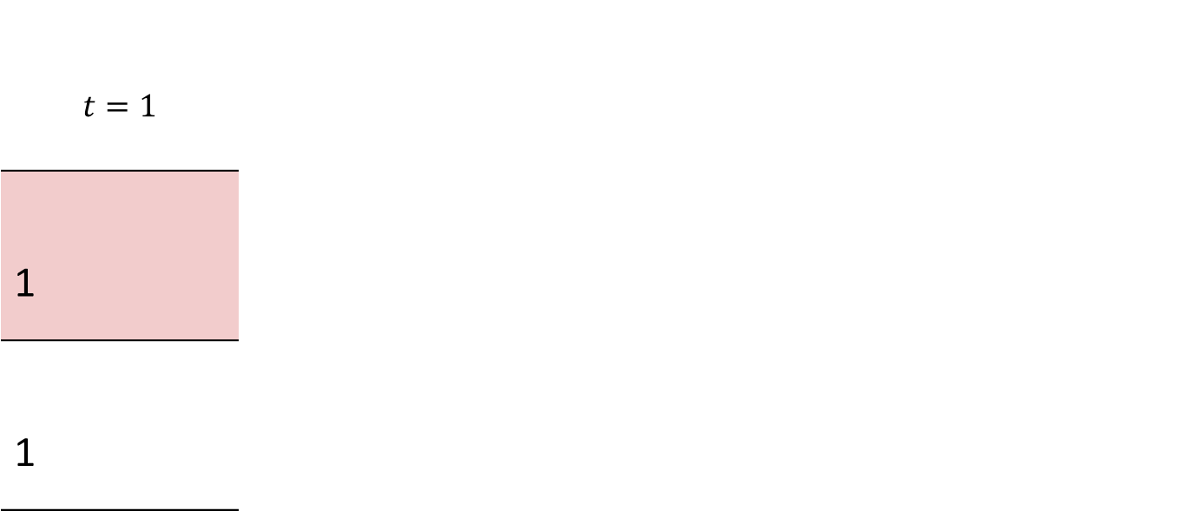
Partial information
Values $v_{it}$ drawn from continuous unknown distribution, $Q_{it}$ is quantile
You can query for an agent’s rank relative to a subset of previous items
$$t=1$$
1
1
1st
1st
Notes:
Adversarial values

Slide 33
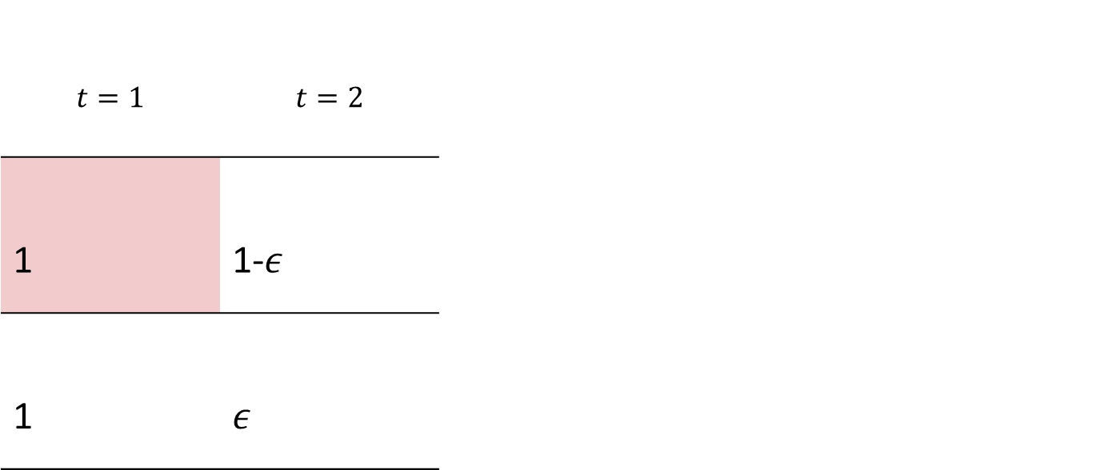
Partial information
Values $v_{it}$ drawn from continuous unknown distribution, $Q_{it}$ is quantile
You can query for an agent’s rank relative to a subset of previous items
$$t=1$$ | $$t=2$$
1 | 1-$ε$
1 | $ε$
1st
2nd
1st
1st
Notes:
Adversarial values

Slide 34
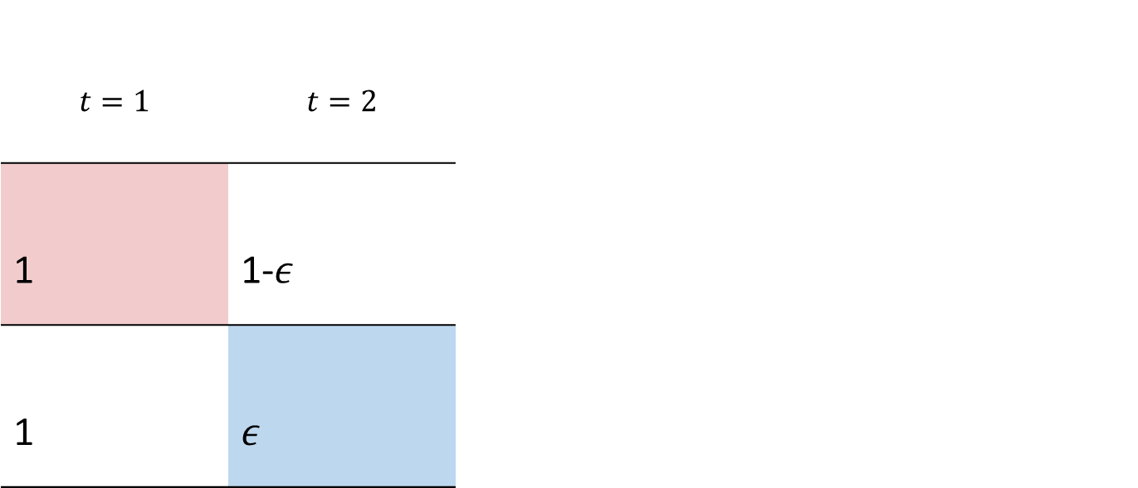
Partial information
Values $v_{it}$ drawn from continuous unknown distribution, $Q_{it}$ is quantile
You can query for an agent’s rank relative to a subset of previous items
$$t=1$$ | $$t=2$$
1 | 1-$ε$
1 | $ε$
1st
2nd
1st
1st
Notes:
Adversarial values

Slide 35

Partial information
Values $v_{it}$ drawn from continuous unknown distribution, $Q_{it}$ is quantile
You can query for an agent’s rank relative to a subset of previous items
$$t=1$$ | $$t=2$$ | $$t=3$$
1 | 1-$ε$ | 1/2
1 | $ε$ | 1/2
1st
2nd
2nd
1st
1st
1st
Notes:
Adversarial values

Slide 36
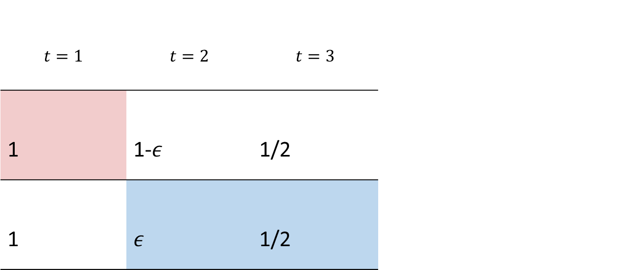
Partial information
Values $v_{it}$ drawn from continuous unknown distribution, $Q_{it}$ is quantile
You can query for an agent’s rank relative to a subset of previous items
$$t=1$$ | $$t=2$$ | $$t=3$$
1 | 1-$ε$ | 1/2
1 | $ε$ | 1/2
1st
2nd
2nd
1st
1st
1st
Notes:
Adversarial values

Slide 37
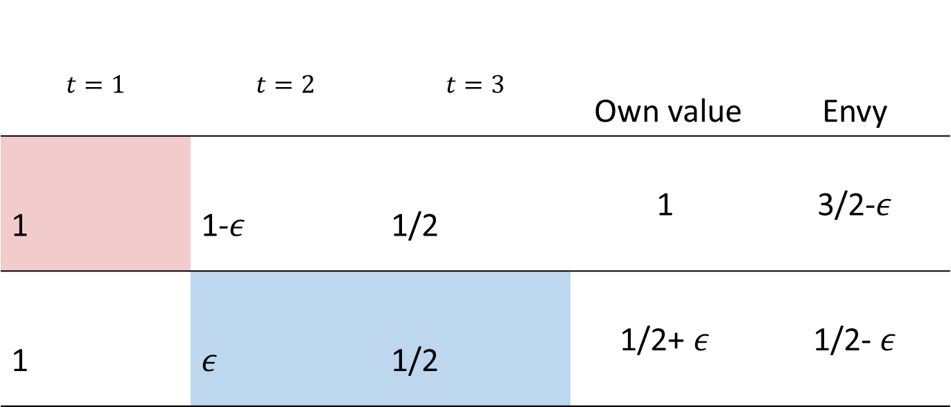
Partial information
Values $v_{it}$ drawn from continuous unknown distribution, $Q_{it}$ is quantile
You can query for an agent’s rank relative to a subset of previous items
$$t=1$$ | $$t=2$$ | $$t=3$$ | Own value | Envy
1 | 1-$ε$ | 1/2 | 1 | 3/2-$ε$
1 | $ε$ | 1/2 | 1/2+ $ε$ | 1/2- $ε$
1st
2nd
2nd
L
1st
1st
1st
L
Notes:
Adversarial values

Slide 38
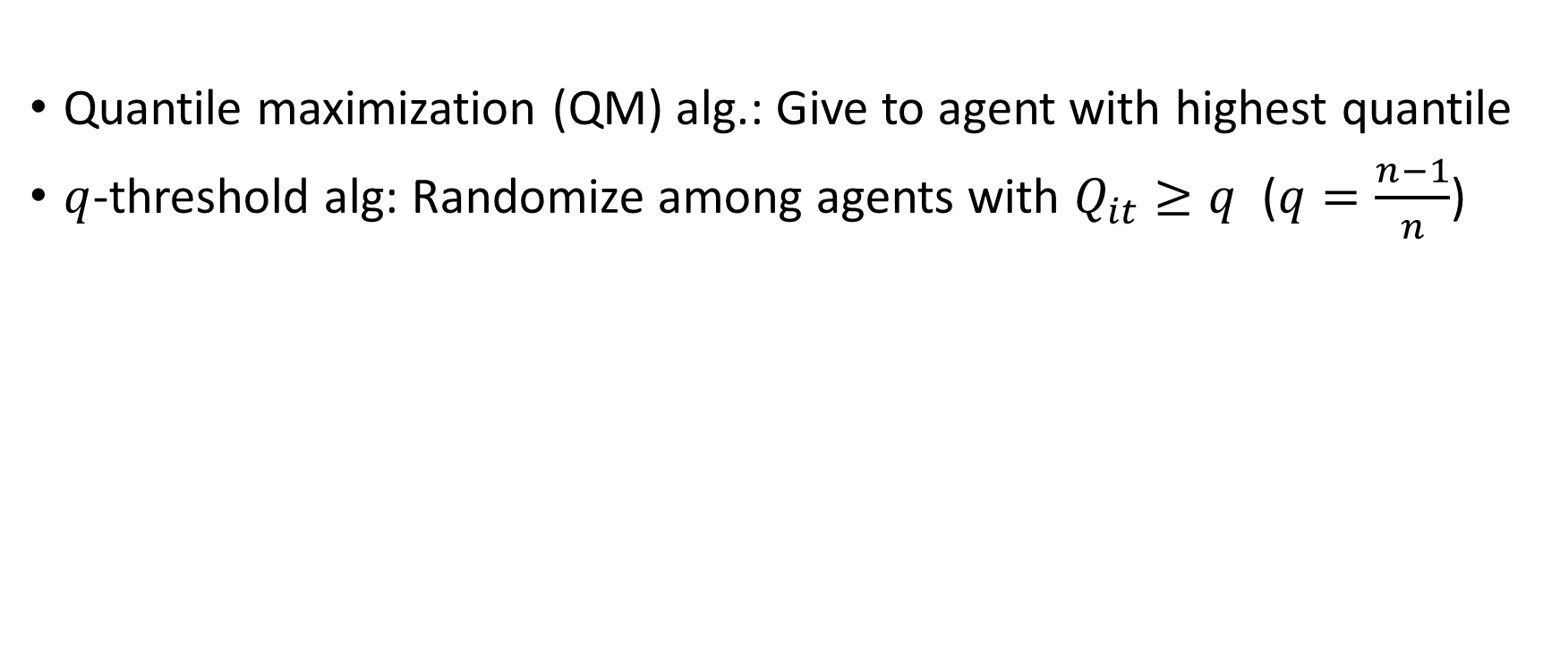
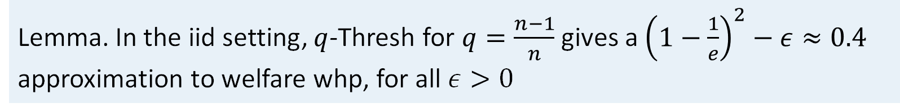
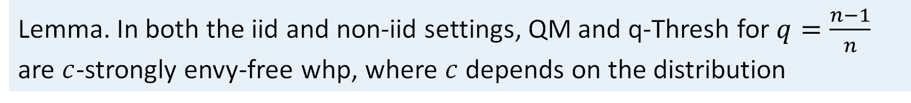
The ideal: quantile-based algorithms
[DKG+14] Allocating to agent with highest value is EF and WO whp ($T≥nlog n$)
Quantile maximization (QM) alg.: Give to agent with highest quantile
$q$-threshold alg: Randomize among agents with $Q_{it}≥q$ ($q=\frac{n−1}{n}$)
Lemma. In both the iid and non-iid settings, QM and q-Thresh for $q=\frac{n−1}{n}$ are $c$-strongly envy-free whp, where $c$ depends on the distribution
Lemma. In the iid setting, $q$-Thresh for $q=\frac{n−1}{n}$ gives a ${\left(1−\frac{1}{e}\right)}^{2}−ε≈0.4$ approximation to welfare whp, for all $ε>0$
Notes:
Analogue: QM. Alternative – much coarser quantile info, compares to a singke threshold.
Use these as inspiration
strictly EF with constant gap is useful, we’ll make some mistakes.
Lem1: Analysis similar to Dickerson et al with slightly different technical assumptions
IID – QM is welfare optimal
n/(n-1): big errors when no one is above the threshold. 1 – (1-1/n)^n, which shows where 1-1/e comes from.
- Roughly 1/e prob of exactly one agent having high value, so any agent receives ~1/e fraction of their highest value items.
Goal – learn quantiles accurately enough : few mistakes + similar guarantees, for all distributions

Slide 39
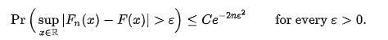
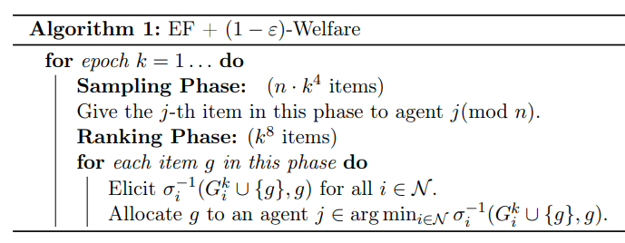
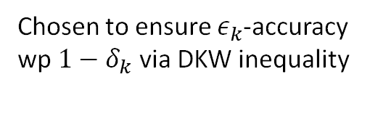
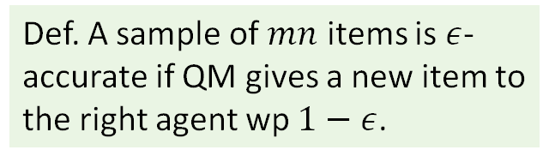
Unbounded memory
DKW ineq:
Def. A sample of $mn$ items is $ε$-accurate if QM gives a new item to the right agent wp $1−ε$.
QM is strongly EF and WO whp
Approximate QM with empirical quantiles
Analysis: allow sublinear number of mistakes compared to QM
Chosen to ensure $ε_{k}$-accuracy wp $1−δ_{k}$ via DKW inequality
Increasing epoch lengths
Exploit much longer than explore
Allocate to agent ranking item highest
compared to this sampling phase
Thm. In the iid model, Alg 1 is EF and $\left(1−ε\right)$-WO whp, for $ε>0.$
Notes:
-expl/expl: build constant envy gap when ranking, careful not to eliminate while sampling
-increasing epoch lengths: handle unknown distributions. Any fixed sampling phase, some distribution where this is not enough
Dvoretzky–Kiefer–Wolfowitz
Epsilon accurate – DKW inequality: empirical CDF concentrates around true exponentially quickly: for all agents – union bounds
Mistakes –first epochs, all sampling phases, wp eps in rank (1-delta), all rank (delta)
Great – partial info, guarantees that are tight and very similar to full information case.
Welfare approx. – NEEDED – nothing can be even oneswap PO perfectly

Slide 40
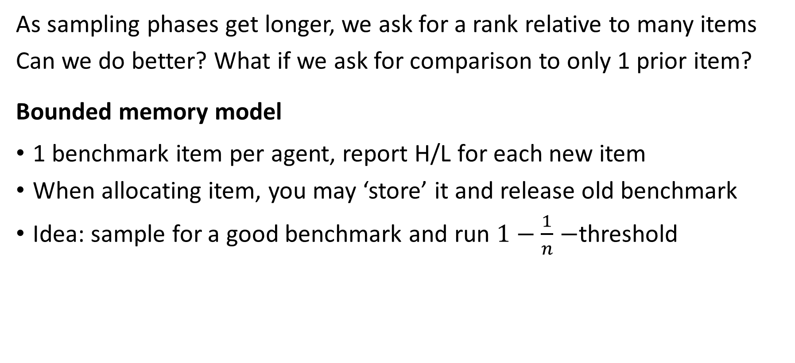
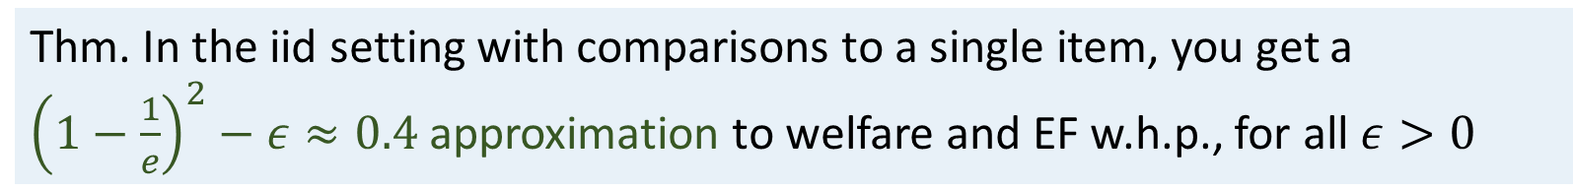
Thinking about memory
As sampling phases get longer, we ask for a rank relative to many items
Can we do better? What if we ask for comparison to only 1 prior item?
Bounded memory model
1 benchmark item per agent, report H/L for each new item
When allocating item, you may ‘store’ it and release old benchmark
Idea: sample for a good benchmark and run $1−\frac{1}{n}−$threshold
Thm. In the iid setting with comparisons to a single item, you get a ${\left(1−\frac{1}{e}\right)}^{2}−ε≈0.4$ approximation to welfare and EF w.h.p., for all $ε>0$
Notes:
Rank relative to many items – binary search, T-> infty, annoying.
start by assuming you cant give a true value, then it is a little weird to as for a position in a ranking (quantile)
Sampling phase: allocate randomly. estimate benchmark quantile from H/L, keep for exploit phase if “close enough” to $1−\frac{1}{n} ,$ o.w. reject and repeat
Exploit phase: Run $q$-threshold with the benchmarks – randomize among agents who report the new item’s value is higher than benchmark.
Other tricks: Increasing epoch lengths, tightening definition of “close enough” since it has to work for every distribution
You can do no better than a constant approximation to envy with bounded memory

Slide 41



Bounded memory
Thm. In the iid setting with 1 item memory, no algorithm is 0.999 welfare maximizing whp for all continuous and bounded distributions.
Strategy (Alg 2, informally):
Sampling phase: allocate randomly. estimate benchmark quantile from H/L, keep for exploit phase if “close enough” to $1−\frac{1}{n} ,$ o.w. reject and repeat
Exploit phase: Run $q$-threshold with the benchmarks – randomize among agents who report the new item’s value is higher than benchmark.
Other tricks: Increasing epoch lengths, tightening definition of “close enough” since it has to work for every distribution
Recall. In the iid setting, $q$-Thresh for $q=\frac{n−1}{n}$ gives a ${\left(1−\frac{1}{e}\right)}^{2}−ε≈0.4$ approximation to welfare w.h.p ., for all $ε>0$
Thm. In the iid setting with memory 1, Alg 2 gives a ${\left(1−\frac{1}{e}\right)}^{2}−ε≈0.4$ approximation to welfare and is EF w.h.p., for all $ε>0$
Notes:
Have good building block
Technical difficulties,
A lot of sampling, reasonable chance that not everyone finds a good benchmark
for all good benchmarks, not everyone has the same threshold
Gap to close.
Also works for non-iid: 0.37 form both mem1 + meminfty. Doesn’t get much worse. (0.37, 0.8)

Slide 42

Thm. In the iid model with unbounded memory, Alg 1 is EF and $\left(1−ε\right)$-WO whp
Recall. $\frac{n−1}{n}$-Thresh gives a ${\left(1−\frac{1}{e}\right)}^{2}−ε≈0.4$ approx to welfare w.h.p ., for all $ε>0$

Slide 43


Extensions
Correlated values, $v_{it}=v_{t}+ε_{it}$ with $v_{t}∼D, ε_{it}∼D_{noise}$
Non-iid values, $v_{it}∼D_{i}$
Thm. In the iid model, Alg 1 is EF and $\left(1−ε\right)$-WO whp, for $ε>0.$
Lemma. (Non-iid) QM and $\frac{n−1}{n}$-Thresh gives a $\frac{1}{e}−ε≈0.37$ approx to PO w.h.p.
(gap: 0.809-PO wp 2/3 even with quantiles)
Notes:
Non-iid – need constant approx., no better than 0.81
Flexible analysis tools, variety of settings. Various levels of robustness checks in different variants

Slide 44


Simulations
Without values you lose 10-100x more items
95th percentile welfare

Slide 45

Fairness, efficiency
Envy: does any agent prefer another’s allocation over their own?
$envy_{ij}=v_{i}\left(A_{j}\right)−v_{i}(A_{i})$
If no agent envies another the allocation is envy-free
A is Pareto optimal when there is no A’ where no-one is worse off and someone is strictly better off
Utility vector $v(A)$ is PO if there is no $v\left(A^{′}\right)$ dominating it
Approximate PO: $v(A)$ is $α$-PO when $\frac{1}{α}v(A)$ is undominated
Let $A^{∗}$ be a welfare optimal allocation, ie it maximizes $\sum_{i}{v_{i}(A_{i})}$
$A$ is an $α$-approximation to welfare when $\sum_{i}{v_{i}(A_{i})}≥α⋅\sum_{i}{v_{i}(A_{i}^{∗})}$
Notes:
Dividing resources fairly between agents with different preferences
Classical example non-homogeneous cake
envy: satisfied
With indivisible items, envy-free allocations need not exist

Slide 46

With known item values
Nothing known about non-adaptive
Adversarial values [BKPP18, BKPPZ22]
Random allocation has envy $O(\sqrt{T})$ whp (derandomize)
Every algorithm has envy $Ω(\sqrt{T})$ against an adaptive adversary
Fairness-Efficiency tradeoff: No alg with sublinear envy is more efficient than random allocation [PZ19, BKPPZ22]
Values drawn from a distribution [PZ19, BKPPZ22]
No fairness-efficiency tradeoff even for correlated values
Core idea from [DKG+14, KPW16]: For values drawn iid from some distribution, allocating each item to the agent with highest value is welfare optimal and EF whp (for more than $n\log{n}$ items)
Delay allocations (buy a fridge)
Allow reallocations
Beyond additive values
Notes:
Other things: what if you are allowed modifications, what if you can delay allocating a small number of items etc.
Another model: agents arrive, decide how much of pool to give them. Sid Banerjee has some work on this.
Enough background, ... Let’s take stock of where we are.

Slide 47

With known item values
Adversarial values [BKPP18, BKPPZ22]
Random allocation has envy $O(\sqrt{T})$ whp (derandomize)
Every algorithm has envy $Ω(\sqrt{T})$ against an adaptive adversary
Fairness-Efficiency tradeoff: No alg with sublinear envy is more efficient than random allocation [PZ19, BKPPZ22]
Values drawn from a distribution [PZ19, BKPPZ22]
No fairness-efficiency tradeoff even for correlated values
Core idea from [DKG+14, KPW16]: For values drawn iid from some distribution, allocating each item to the agent with highest value is welfare optimal and EF whp (for more than $n\log{n}$ items)
Notes:
Other things: what if you are allowed modifications, what if you can delay allocating a small number of items etc.
Another model: agents arrive, decide how much of pool to give them. Sid Banerjee has some work on this.
Enough background, ... Let’s take stock of where we are.

Slide 48



Can we fairly and efficiently allocate goods online, with only partial information?
Target: Envy-free whp as $T→∞$
Target: PO or welfare maximizing whp as $T→∞$
Value $v_{it}$ drawn iid on arrival from unknown continuous, bounded distribution
Agents report ranking of item relative to a subset of their bundle
Notes:
Why do we have any hope – start by showing that some forms of partial information is useful

Slide 49

A glimmer of hope: quantile-based algorithms
[DKG+14] Allocating to agent with highest value is EF and WO whp ($T≥nlog n$)
Quantile maximization (QM) alg.: Give to agent with highest quantile
$q$-threshold alg: Randomize among agents with $Q_{it}≥q$
Lemma. In both the iid and non-iid settings, QM and q-Thresh for $q=\frac{n−1}{n}$ are $c$-strongly envy-free whp, where $c$ depends on the distribution
Lemma. In the iid setting, $q$-Thresh for $q=\frac{n−1}{n}$ gives a ${\left(1−\frac{1}{e}\right)}^{2}−ε≈0.4$ approximation to welfare whp, for all $ε>0$
Notes:
Analogue: QM. Alternative – much coarser quantile info, compares to a singke threshold.
Use these as inspiration
strictly EF with constant gap is useful, we’ll make some mistakes.
Lem1: Analysis similar to Dickerson et al with slightly different technical assumptions
IID – QM is welfare optimal
n/(n-1): big errors when no one is above the threshold. 1 – (1-1/n)^n, which shows where 1-1/e comes from.
- Roughly 1/e prob of exactly one agent having high value, so any agent receives ~1/e fraction of their highest value items.
Goal – learn quantiles accurately enough : few mistakes + similar guarantees, for all distributions

Slide 50








IID model, unbounded memory
We need some approximation to welfare
Proof sketch (for U[0,1]): we know nothing about the first item
With some constant probability, we make a disastrous mistake
(1) PO requires all future items in $R_{1}$ go to ag. 1
(2) Ag. 2 has value $≥0.7tE\left[X\right]$ for such items whp
(3) Ag. 2’s total value $≤1.1tE\left[X\right]$ whp
When (1), (2) and (3) happen (with constant prob) the algorithm can not be EF
Thm. In the iid model for 2 agents, no algorithm is one-swap PO and EF w.h.p., even for values sampled from a known continuous and bounded distrib..
$$q_{2}$$
1
$$0.9$$
$$t$$
$$v_{2}$$
$$q_{1}$$
$$v_{1}$$
$$0.1$$
Notes:
Assume we give it to

Slide 51
Unbounded memory
We need some approximation to efficiency
Proof sketch (for U[0,1]): we know nothing about the first item
With some constant probability, we make a disastrous mistake
Thm. In the iid model for 2 agents, no algorithm is one-swap PO and EF w.h.p., even for values sampled from a known continuous and bounded distrib..
Notes:
We can do a lot with quantiles, and we can estimate quantiles, so we’re good!
Hang on a bit… we cant expect exact efficiency.
QM is welfare opt – cant even get one-swap PO

Slide 52
Unbounded memory
We need some approximation to efficiency
Proof sketch (for U[0,1]): we know nothing about the first item
With some constant probability, we make a disastrous mistake
Thm. In the iid model for 2 agents, no algorithm is one-swap PO and EF w.h.p., even for values sampled from a known continuous and bounded distrib..
$$q_{2}$$
1
$$0.9$$
$$v_{2}$$
$$q_{1}$$
$$v_{1}$$
$$0.1$$
Notes:
Assume we give it to

Slide 53


Unbounded memory
We need some approximation to welfare
Proof sketch (for U[0,1]): we know nothing about the first item
With some constant probability, we make a disastrous mistake
(1) PO requires all future items in $R_{1}$ go to ag. 1
(2) Ag. 2 has value $≥0.7tE\left[X\right]$ for such items whp
For U[0,1]: $E\left[v_{2}\left(R_{1}\right)\right]=0.81⋅t⋅0.45$
$=0.81⋅t⋅0.9 E\left[X\right]$
$≥0.72⋅t⋅E[X]$
Thm. In the iid model for 2 agents, no algorithm is one-swap PO and EF w.h.p., even for values sampled from a known continuous and bounded distrib..
$$q_{2}$$
1
$$0.9$$
$$R_{1}$$
$$t$$
$$v_{2}$$
$$q_{1}$$
$$v_{1}$$
$$0.1$$
Notes:
Assume we give it to

Slide 54
Unbounded memory
We need some approximation to welfare
Proof sketch (for U[0,1]): we know nothing about the first item
With some constant probability, we make a disastrous mistake
(1) PO requires all future items in $R_{1}$ go to ag. 1
(2) Ag. 2 has value $≥0.7tE\left[X\right]$ for such items whp
(3) Ag. 2’s total value $≤1.1tE\left[X\right]$ whp
When (1), (2) and (3) happen (with constant prob) the algorithm can not be EF
Thm. In the iid model for 2 agents, no algorithm is one-swap PO and EF w.h.p., even for values sampled from a known continuous and bounded distrib..
$$q_{2}$$
1
$$0.9$$
$$t$$
$$v_{2}$$
$$q_{1}$$
$$v_{1}$$
$$0.1$$
Notes:
Assume we give it to

Slide 55
Unbounded memory
DKW ineq:
Def. A sample of $mn$ items is $ε$-accurate if QM gives a new item to the right agent wp $1−ε$.
QM is strongly EF and WO whp
Approximate QM with empirical quantiles
Analysis: allow sublinear number of mistakes compared to QM
Chosen to ensure $ε_{k}$-accuracy wp $1−δ_{k}$ via DKW inequality
Increasing epoch lengths
Exploit much longer than explore
Allocate to agent ranking item highest
compared to this sampling phase
Thm. In the iid model, Alg 1 is EF and $\left(1−ε\right)$-WO whp, for $ε>0.$
Notes:
-expl/expl: build constant envy gap when ranking, careful not to eliminate while sampling
-increasing epoch lengths: handle unknown distributions. Any fixed sampling phase, some distribution where this is not enough
Dvoretzky–Kiefer–Wolfowitz
Epsilon accurate – DKW inequality: empirical CDF concentrates around true exponentially quickly: for all agents – union bounds
Mistakes –first epochs, all sampling phases, wp eps in rank (1-delta), all rank (delta)
Great – partial info, guarantees that are tight and very similar to full information case.

Slide 56

Thm. In the iid model, Alg 1 is EF and $\left(1−ε\right)$-WO whp, for $ε>0.$
Proof sketch: QM is $c$-strongly EF
$⇒ {envy}_{ij}^{QM}$ $≈− cT/n$ whp
$⇒$ EF if a sub-linear number mistakes
Mistakes compared to QM:
1. All of the first $3n−1$ epochs
2. Sampling phase of epoch $k≥3n$
3. Ranking phase of epoch $k≥3n, ε_{k}$-accurate (wp $1−δ_{k}$)
4. Ranking phase of epoch $k≥3n$, not $ε_{k}$-accurate (wp $δ_{k}$)
Check the total mistakes is sublinear in $T$ and confirm $(1−ε)$ WO
Notes:
Constant in T
~ sqrt(epoch length)
Pick phase lengths to control these terms – possible

Slide 57
Thinking about memory
Thm. In the iid model with unbounded memory, Alg 1 is EF and $\left(1−ε\right)$-WO whp
As sampling phases get longer, we ask for a rank relative to many items
Can we do better? What if we ask for comparison to only 1 prior item?
Bounded memory model
1 benchmark item per agent, report H/L for each new item
When allocating item, you may ‘store’ it and release old benchmark
Once an item is allocated and not stored or stored and subsequently released, it can not be made benchmark again
Notes:
Rank relative to many items – binary search, T-> infty, annoying.
start by assuming you cant give a true value, then it is a little weird to as for a position in a ranking (quantile)

Slide 58

Bounded memory, constant approximation
Proof sketch for $n=2$.
Assume values are drawn from U[0,1]. Let $q_{1},q_{2}$ be the quantiles of the benchmark item of agents 1, 2. Wlog assume $q_{1}≤q_{2}.$
Consider the intervals $\left[0,q_{1}\right], \left[q_{1},q_{2}\right], \left[q_{2}, 1\right].$ At least one is $≥1/3$
Suppose its $I=\left[q_{1},q_{2}\right]$. Item $t$ has $Q_{1t}∈I$ and $Q_{2t}∈I$ wp $≥1/9$
Conditioned on $t∈I$, $E[v_{high}−v_{low}]$ $≥$ 1/9, equally likely either
Any alg allocates to some agent wp at most ½ when in $I$
Expected loss per item: $\frac{1}{9}⋅\frac{1}{2}⋅\frac{1}{9}=\frac{1}{162}.$ Whp it concentrates, $≥\frac{1}{1000}$
Thm. In the iid setting with 1 item memory, no algorithm is 0.999 welfare maximizing whp for all continuous and bounded distributions.
Notes:
Has cost : Constant approx. is the best we can do
General n: quantiles are still unif01, set up the distribution so that there is a similar range of uncertainty

Slide 59

Bounded memory
Recall. In the iid setting, $q$-Thresh for $q=\frac{n−1}{n}$ gives a ${\left(1−\frac{1}{e}\right)}^{2}−ε≈0.4$ approximation to welfare w.h.p ., for all $ε>0$
Strategy (Alg 2, informally):
Sampling phase: allocate randomly. estimate benchmark quantile from H/L, keep for exploit phase if “close enough” to $1−\frac{1}{n} ,$ o.w. reject and repeat
Exploit phase: Run $q$-threshold with the benchmarks – randomize among agents who report the new item’s value is higher than benchmark.
Other tricks: Increasing epoch lengths, tightening definition of “close enough” since it has to work for every distribution
Thm. In the iid setting with memory 1, Alg 2 gives a ${\left(1−\frac{1}{e}\right)}^{2}−ε≈0.4$ approximation to welfare and is EF w.h.p., for all $ε>0$
Notes:
Have good building block
Technical difficulties,
A lot of sampling, reasonable chance that not everyone finds a good benchmark
for all good benchmarks, not everyone has the same threshold
Gap to close.
Also works for non-iid: 0.37 form both mem1 + meminfty. Doesn’t get much worse. (0.37, 0.8)

Slide 60
Food rescue application
With Aydin Alptekinoglu

Slide 61
Food rescue operations
Act as a matching platform between donors and recipients
Active in 50 states, 2.9mil pounds in 2022

Slide 62
Food rescue operations
Act as a matching platform between donors and recipients
Active in 50 states, 2.9mil pounds in 2022

Slide 63
Food rescue operations
Act as a matching platform between donors and recipients
Active in 50 states, 2.9mil pounds in 2022
YES

Slide 64
Food rescue operations
Act as a matching platform between donors and recipients
Active in 50 states, 2.9mil pounds in 2022

Slide 65
Food rescue operations
Act as a matching platform between donors and recipients
Active in 50 states, 2.9mil pounds in 2022
YES

Slide 66
Food rescue operations
Act as a matching platform between donors and recipients
Active in 50 states, 2.9mil pounds in 2022

Slide 67


What are the results?
Bottom of recipients 60% get 10% of items

Slide 68

What are the results?

Slide 69
Our theory doesn’t really fit
Model
Here
Items arrive online
Agents have values for items
Fairness metric: envy
Algorithm decides allocation
Items arrive online
We don’t know item values
Can’t use envy as metric
Algorithm doesn’t get to allocate
Response rates

Slide 70




Model
Recipients have exponentially distributed response rates $λ_{i}$
$R_{t}$ is the set of agents within radius of item $t$
Item $t$ has deadline $D_{t}$, item allocated with prob $1−α$ by time $D_{t}$
Objective: Rawlsian fairness – maximize worst-off agent
When donation $t$ arrives
$$\max_{x}{\min_{agents i∈R_{t}}{v_{i}( X_{i}^{t−1}, x )} s.t. {\left|x\right|}_{1}≥1−α}$$
Existing allocation of prior items
Wastage constraint
Expected allocation of item $t$
Increasing in $x$
$x$ is expected outcome of priority list by time $D_{t}$
Number of items
Pounds of items
Frac of agent’s demand

Slide 71




Priority lists
First-claim, first serve BUT delay announcing to the fastest responders
$n$-stage priority list: Ordering of recipients with announcement times
2-stage/binary priority list: Subset of recipients, priority time
1hr
3hrs
2 days
0
2hrs
2 days
0
Notes:
You could imagine other things, artificial currency, wait for two to respond give to worst-off etc

Slide 72









Example
1, 2, 3
No PL
$$∞$$
$$X= \left(\frac{1}{6},\frac{2}{6},\frac{3}{6}\right)$$
0
n-stage PL
$$X= \left(\frac{1}{3},\frac{1}{3},\frac{1}{3}\right)$$
$$t_{1}$$
$$t_{2}$$
$$∞$$
0
Deadline
$$P\left(alloc by time\frac{1}{2}\right)≈0.95$$
$$1/2$$
0
$$X= \left(\frac{0.95}{6},\frac{2⋅0.95 }{6},\frac{3⋅0.95}{6}\right)$$
Notes:
n-stage can achieve any fraction without deadline, 2 stage obviously cant

Slide 73
Example
Best with 2 stage priority list in same example

Slide 74




$$X= \left(\frac{1}{6},\frac{2}{6},\frac{3}{6}\right)$$
1
2
3
$$t_{2}$$
$$t_{3}$$
$$X= \left(\frac{1}{3},\frac{1}{3},\frac{1}{3}\right)$$
1
1
2
1
2
3

Slide 75









Allocating the first item
No items are allocated yet, max min $x_{i}$
Sorting slow to fast is a good idea
$$p_{1}$$
$$p_{2}$$
$$p_{3}$$
$$t_{1}$$
$$t_{2}$$
1
3
2
$$p_{1}$$
$$p_{2}/4$$
$$3p_{2}/4$$
$$p_{3}/6$$
$3p_{3}/$6
$$2p_{3}/6$$
doesn’t need a head-start over
3
2

Slide 76









Allocating the first item
1
2
3
No items are allocated yet, max min $x_{i}$
Sorting slow to fast is a good idea, $π$
Lemma. Given BPL $(S, t)$, if $S$ is not a prefix of $π,$ you can find $S_{1}⊂S⊂S_{2}, t^{′}$ so that look ‘identical’ on $S_{1}$
$$S$$
$$t$$
$$S_{1}$$
$$t′$$
$$S_{2}$$
$$t$$
Thm. The optimal priority set in a binary priority list is some prefix of $π.$
Given the set you can find the optimal priority time with a linear program.

Slide 77














Allocating the first item
No items are allocated yet, max min $x_{i}$
Sorting slow to fast is a good idea, $π$
Lemma. Given BPL $(S, t)$, if $S$ is not a prefix of $π,$ you can find $S_{1}⊂S⊂S_{2}, t^{′}$ so that look ‘identical’ on $S_{1}$
$$S$$
$$t$$
$$S_{1}$$
- Equal P(alloc by $t)$
- $S_{1}≥$ exp. by $t$
$$t′$$
$$S_{2}$$
$$t$$
Thm. The optimal priority set in a binary priority list is some prefix of $π.$
$$S$$
1
2
4
$$t$$
1
2
3
4
1
2
$$t′$$
1
2
3
4
$$t$$
1
2
3
4
$$S_{1}$$
$$S_{2}$$

Slide 78



Allocating the first item
No items are allocated yet, max min $x_{i}$
Sorting slow to fast is a good idea, $π$
This idea + binary search on $z^{∗}$ extends to
$x_{i}^{z}$ is the amount $i$ needs to reach objective value $z$
future items, $π$ orders by $x_{i}^{z}/λ_{i}$
monotone objective functions
any number of stages (needs a sorting lemma)
Thm. The optimal priority set in a binary priority list is some prefix of $π.$
Given the set you can find the optimal priority time with a linear program.

Slide 79

Binary PL Add image illustrating

Slide 80
Binary PL
Done – (at least for max number of items received, first item)
order slowest to fastest
No gaps, if gaps, apply lemma

Slide 81
Binary PL
This generalizes x^z, etc

Slide 82
Computational results
Allocation data 2017-2023
Item characteristics, recipient characteristics
Avg. claim time: 5 hours; avg. deadline: ~8 days
~90% of items successfully allocated
Estimate response rates
Draw donors, donation sizes from historical distributions
Compare:
FCFS
Optimal binary PL
Heuristic: 50% of eligible recipients get priority for max of 24 hours
Notes:
65% claimed by 1 hour; 60% items available for 1 day

Slide 83


Compare avg allocation times, waste
 | FCFS | ALG
Gini | 0.69 | 0.47
Claim time | 6 hrs | 26.5 hrs
% allocated | 85% | 84.6%
Notes:
No increase in waste

Slide 84

Extensions
Offering transportation services
Breaking bulk
Other allocation policies: Best-of-2, etc.

Slide 85

Discussion
Related exciting work
Vaccine allocation, food truck (by Sid Banerjee, Sean Sinclair et al.)
Gap between theory and practice
Very few organizations elicit agent values (Feeding America)
The algorithm doesn’t usually get to decide the allocation
Logistical constraints: box trucks, storage space, current demand, etc.
Notes:
Deciding the allocation: with agents arriving model request as stochastic, items arriving

